Slide 1
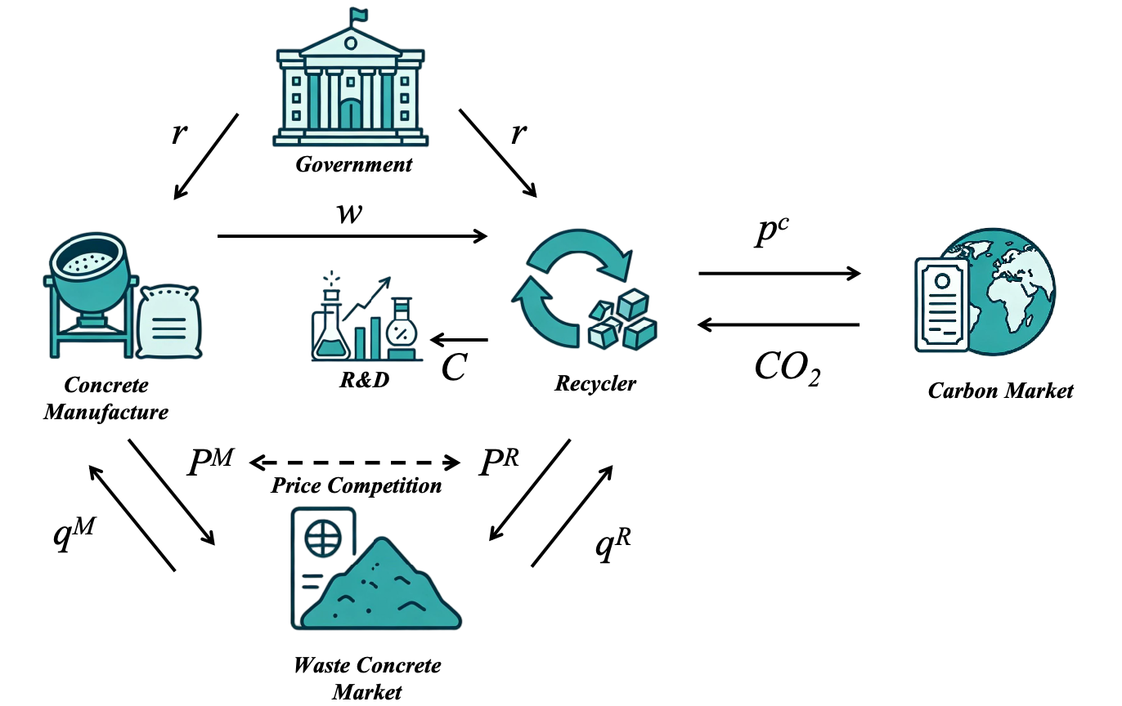
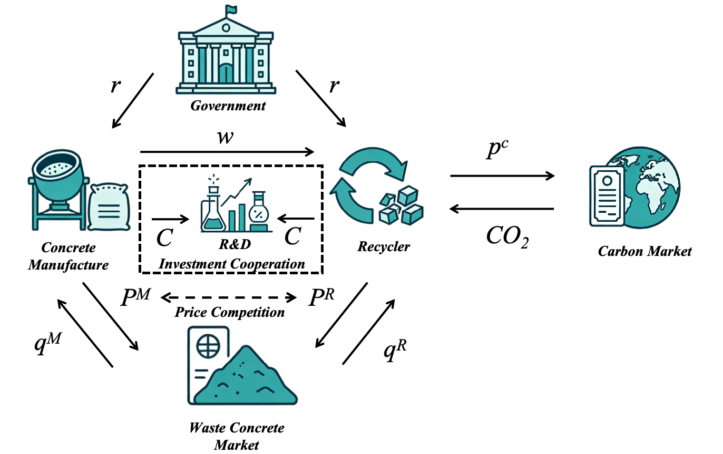
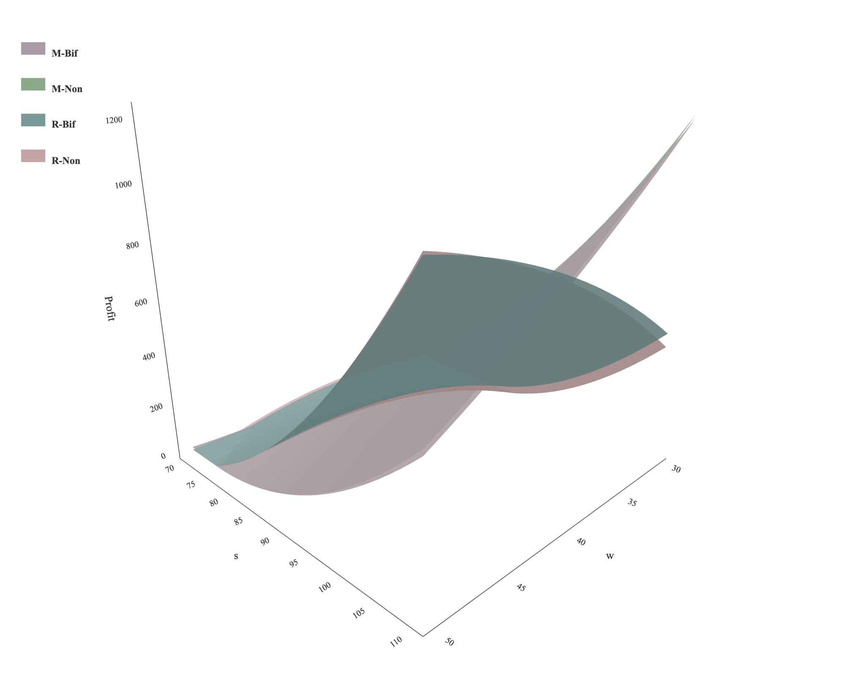
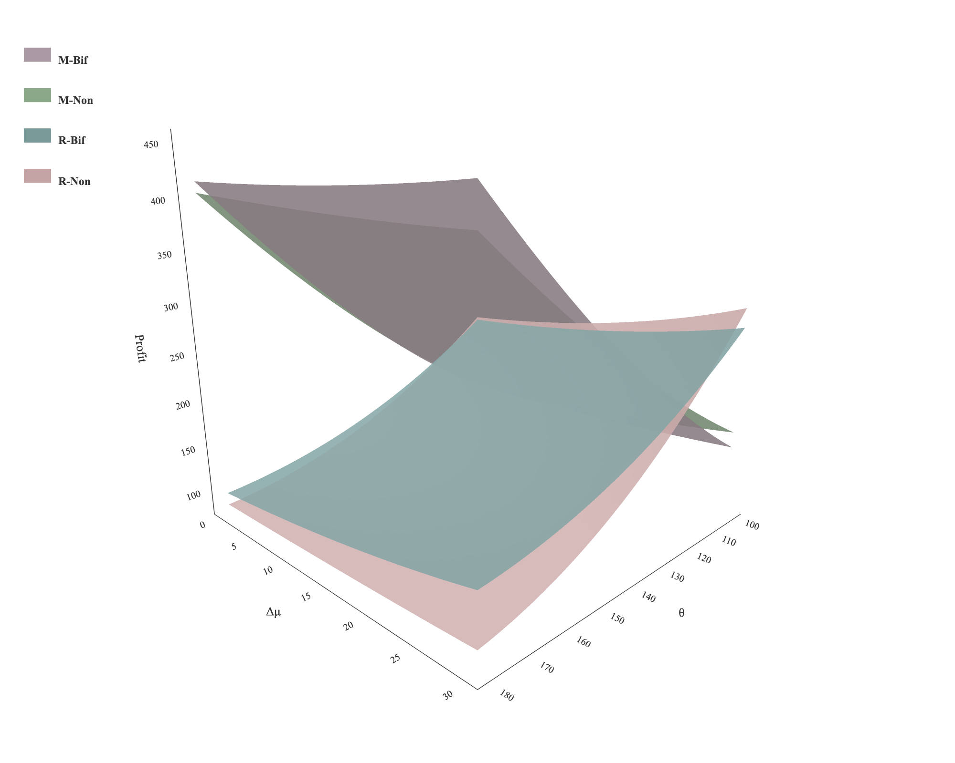
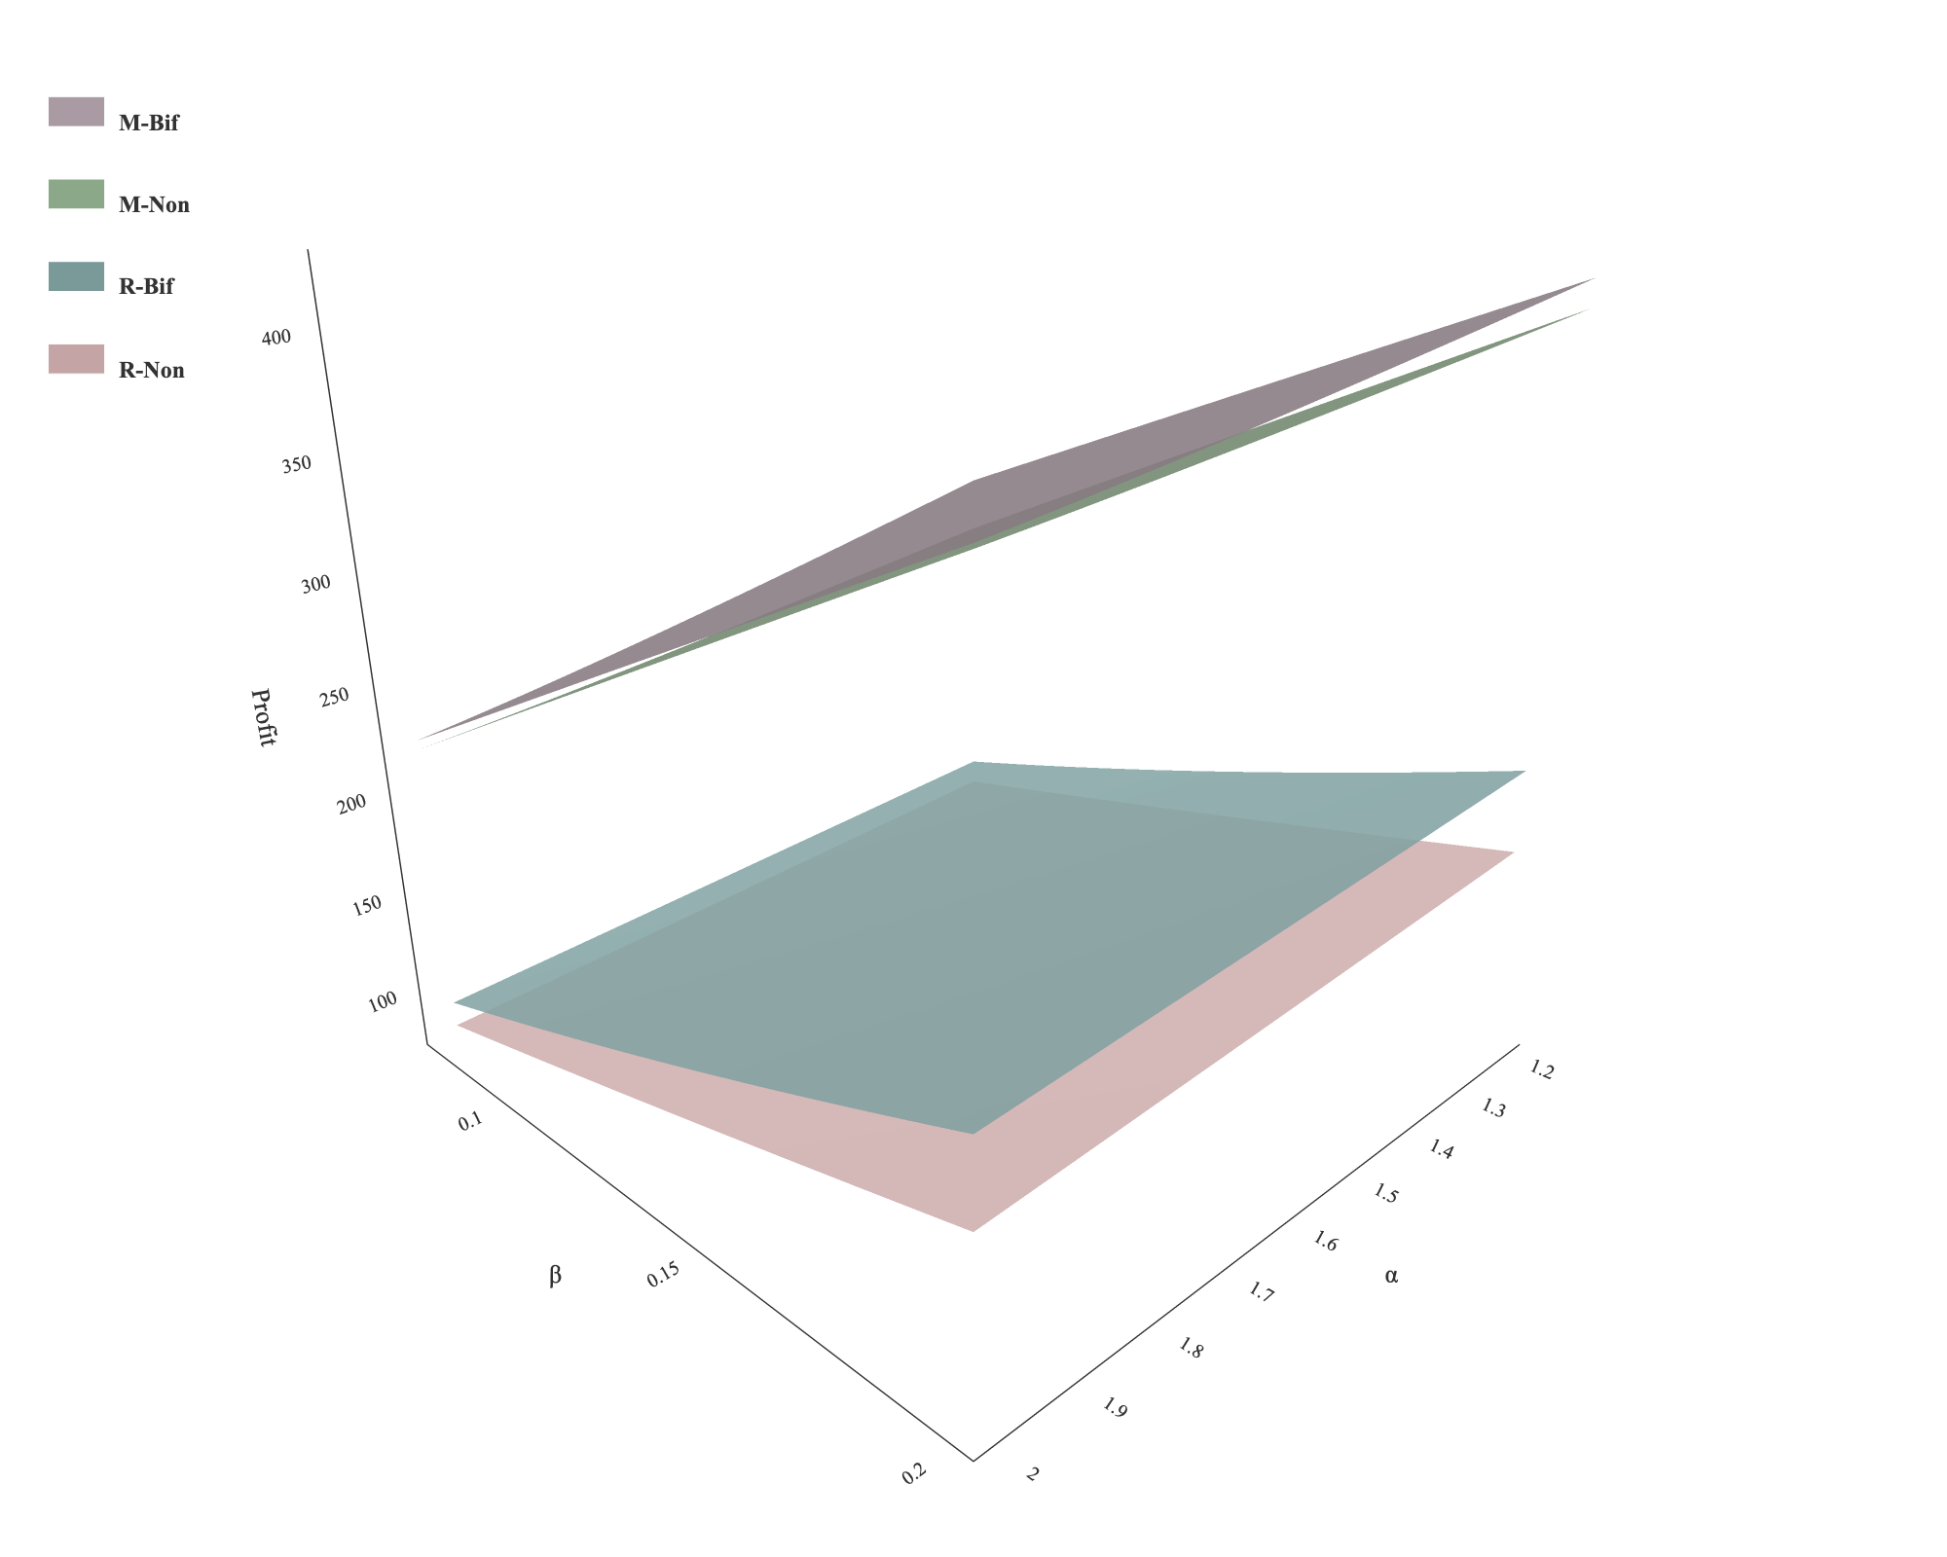
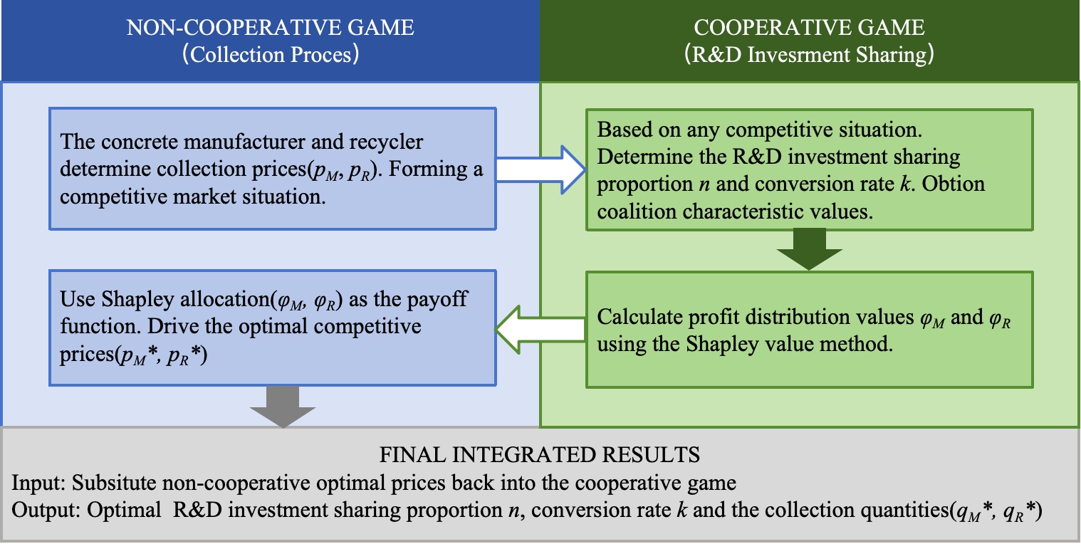
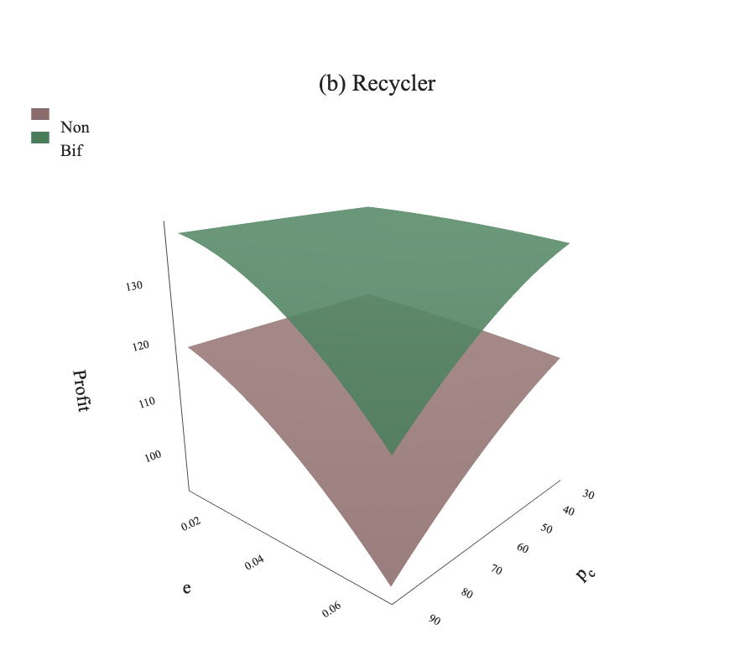
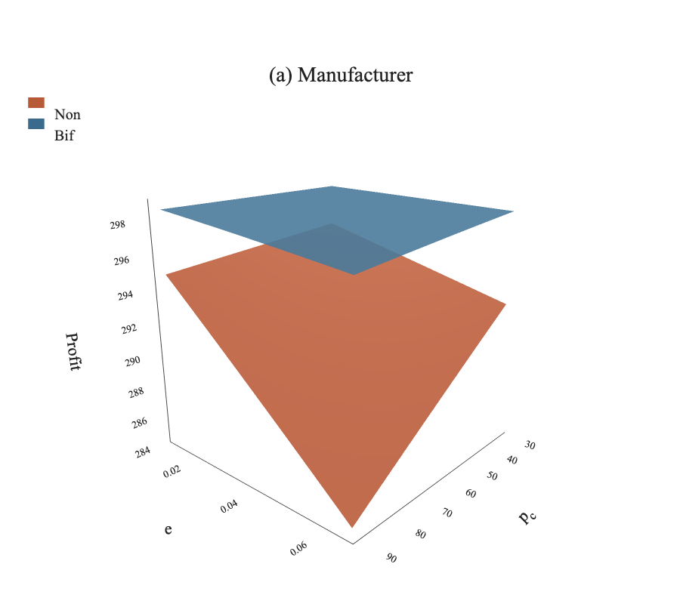
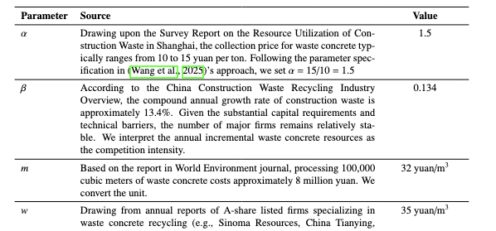
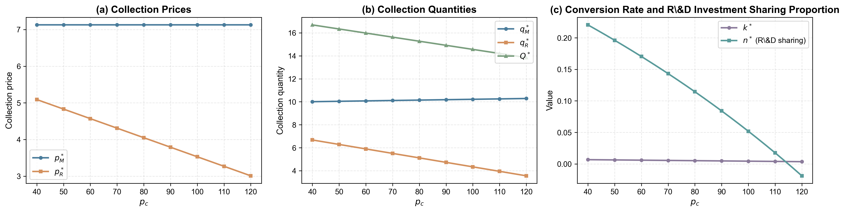
Research Questions
Research Methods
Key Findings
Waste Concrete Recycling
Game modeling and comparison
1. Cooperation in the competition environment is more beneficial for both participants than the pure non-cooperative game model.
Waste Concrete
Concrete Manufacturer
CO₂
Recycler
Non-cooperative
game
Biform game
Research question 1: Considering cap-and-trade mechanism, should concrete manufacturers and recyclers engage in cooperation within the competitive environment?
Decision sequence of the biform game
Competition
Cooperation
Back-end R&D investment sharing
Improving processing technologies
Profit distribution
2. Concerning the impacts of the cap-and-trade mechanism, the study finds that an increase in the carbon trading price generally raises costs and reduces profit margins of the concrete manufacture and the recycler. Cooperation in the competition environment provides a buffering effect against such volatility.
Front-end price competition
Securing limited waste concrete resources
Research question 2: What are the impacts of the cap-and-trade mechanism on the decisions of concrete manufacturers and recyclers in waste concrete recycling?
Numerical simulation
It balances economic benefits with environmental protection in carbon-intensive recycling.
Carbon quotas and price fluctuations directly reshape enterprises' cost structures and profit margins.
Research must address its overlooked impacts on enterprises' co-opetition and economic decisions.
……

